Slide 1
Fluent API
Dot NET COP
2024/11/21

Slide 2
Agenda
1
Overview of Fluent API
2
Pros and cons of using Fluent APIs
3
Use cases of Fluent APIs
4
Overview of Builder Pattern
5
Code Demo

Slide 3
What is Fluent API?
Wikipedia
“relies extensively on method chaining”
“increase code legibility by creating a domain-specific language”
Fowler’s Fluent Interface article
“primarily designed to be readable and to flow”
“chaining is a common technique to use with fluent interfaces, but true fluency is much more than that.”
“The more the use of the API has that language like flow, the more fluent it is.”
Notes:
Good APIs guide their users through a well-lit path, resulting in clearer code, fewer mistakes and better maintainability.

Slide 4
What is Fluent API?
A Fluent API is set of interfaces or methods in which the methods can be chained one after another returning a valid object and can be read in language like flow making it more readable and discoverable for the users.

Slide 5
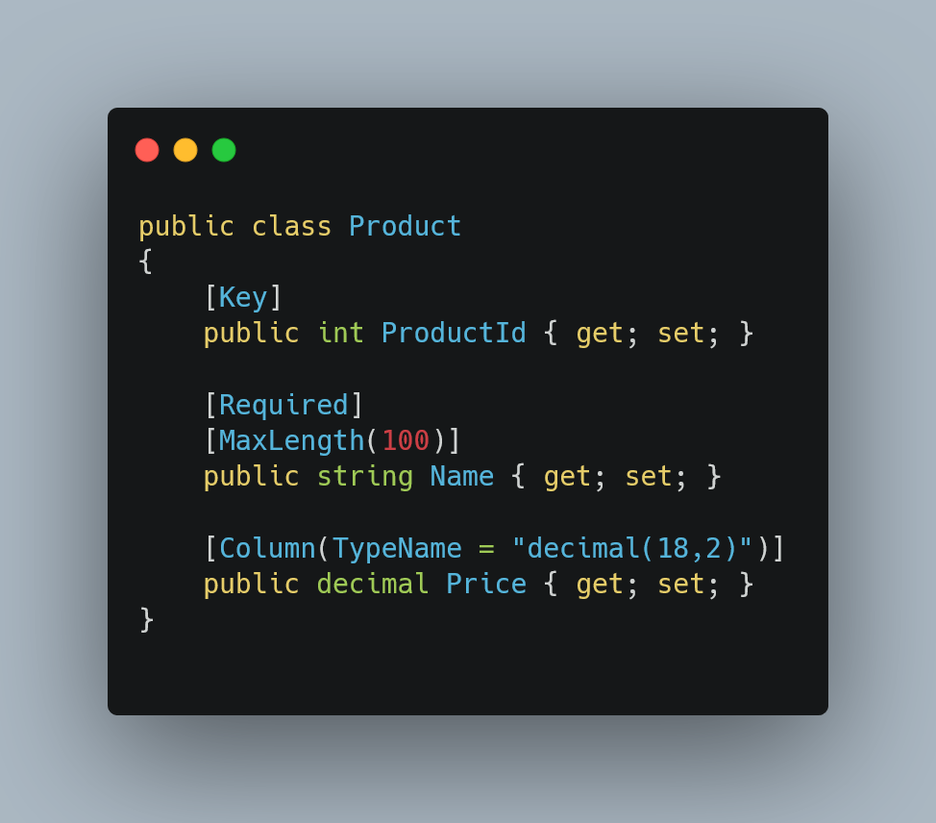
Examples
Defining database constraints in model class using Data Annotations for EF Core

Slide 6
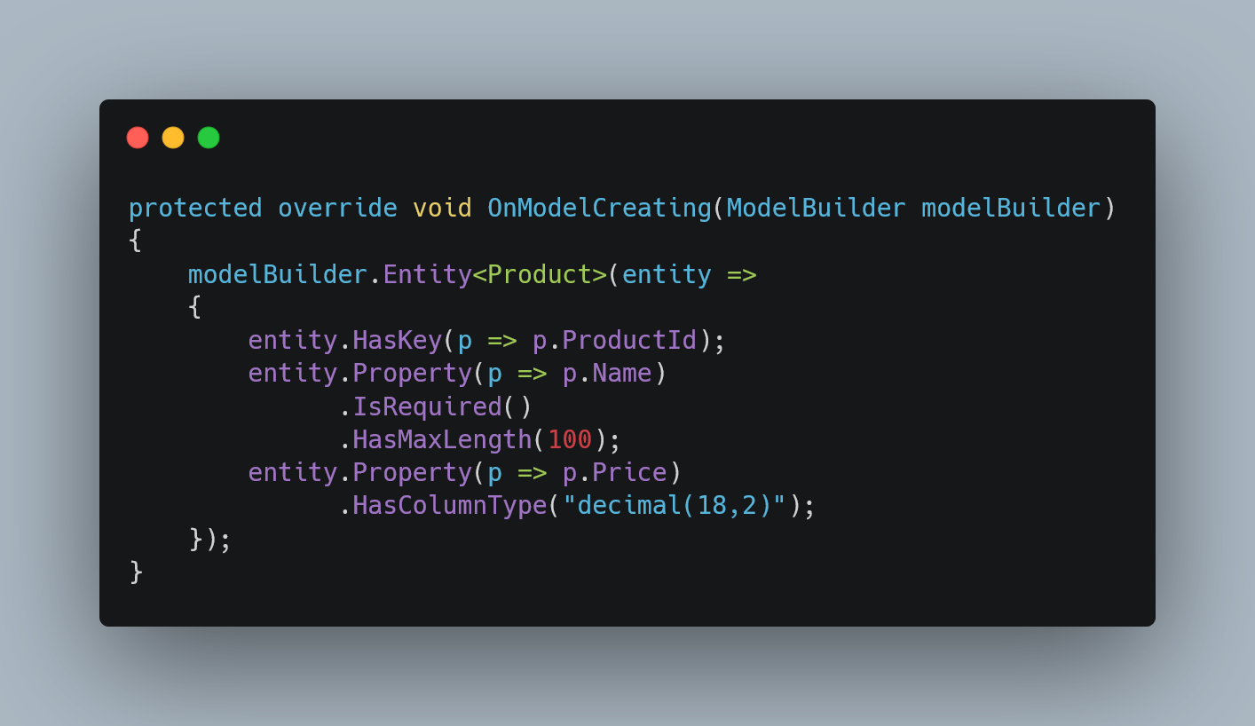
Examples
Defining database constraints using Fluent API for EF Core

Slide 7
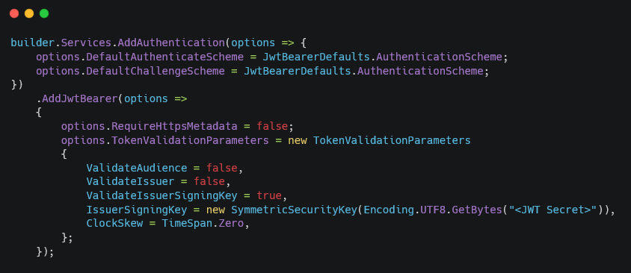
Examples
Adding JWT Authentication using Fluent API

Slide 8
Benefits of Using Fluent API
1
Encapsulates domain-specific operations
2
Provides better code completion and IntelliSense
3
Self documenting code
4
More concise and readable code
5
Enhances developer experience

Slide 9
Cons of Using Fluent API
1
Requires more thoughtful decisions
2
Violates the principle of Command Query Separation
3
Methods do not make sense on their own

Slide 10
Use cases
1
Domain-specific languages
2
Configurable objects
3
Defining long lived utilities

Slide 11
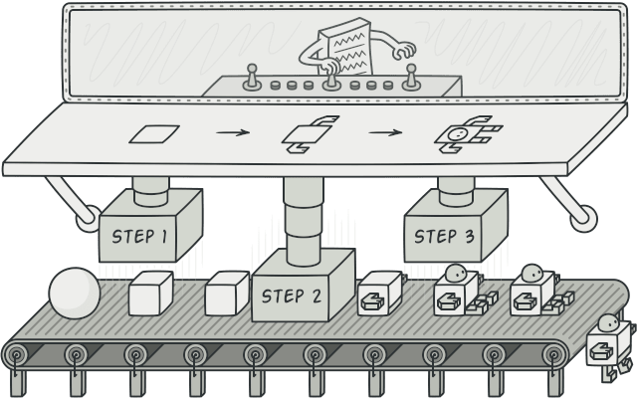
Builder Pattern
Creational design pattern
Allows to create complex objects step by step
Allows to produce different types and representations of an object using the same construction code

Slide 12
Coding Demo

Slide 13
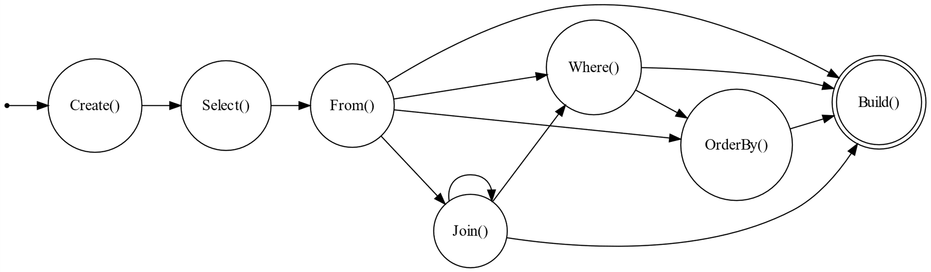
Demo: QueryBuilder

Slide 14
Demo: QueryBuilder
ICanSelect
ICanFrom
ICanJoin
ICanOrderBy
ICanBuild

Slide 15
Any Questions?

Slide 16
Thank You

